Slide 1
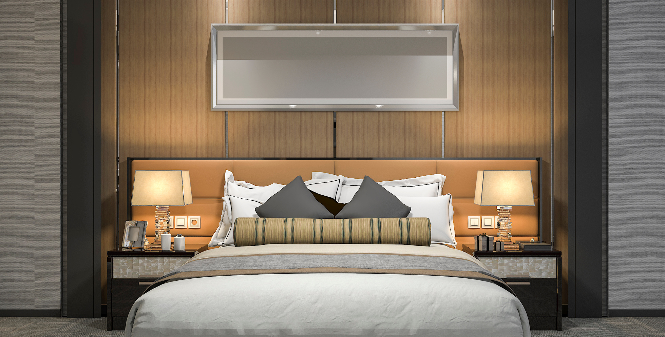
SYNC
SUITES HOTEL RESERVATION SYSTEM

Slide 2


Project Description
Description About Hotel
This system assists hotel staff with daily operations. It allows them to register new guests or retrieve existing records, book rooms, and automatically compute costs and discounts for seniors or persons with disabilities. Real time room availability shows which rooms are vacant, and all data is securely stored in a MySQL database.
For active guests, staff can filter booking records, extend stays, and process room upgrades as needed.
1000+
Hotel Visitors

Slide 3
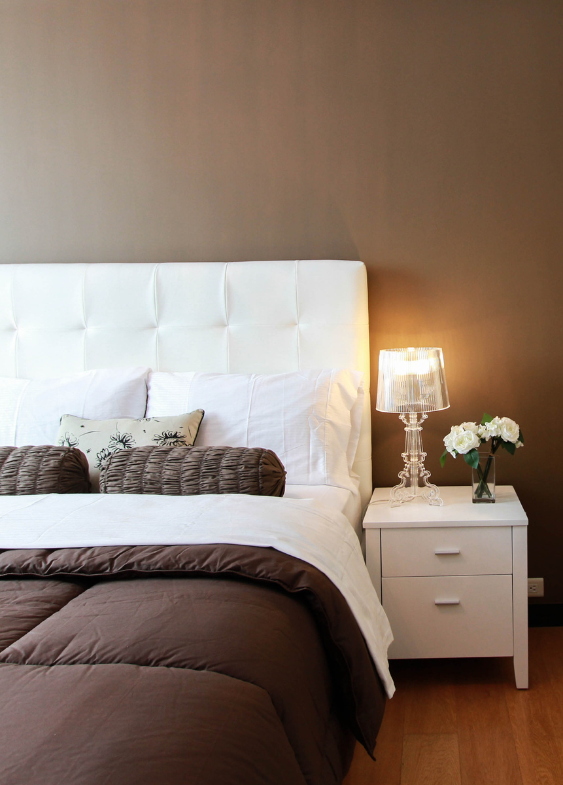
Project Background /
Problem Statement
Many small hotels still rely on paper logbooks, which are slow and prone to errors like double bookings. Manual tracking also makes it difficult to monitor check ins, check outs, room upgrades, or extended stays, and finding specific records takes too long.
Our system solves this by automating the process. It provides instant record filtering, error checking, and real time room status updates.

Slide 4


Warner & Spencer
Administrator
The person in charge can access the whole system by logging in with a username and password, so everything stays secure.
Hotel Receptionist / Staff
Staff can search for customers, register new guests, and book rooms. The system handles discounts, check-ins, check-outs, room upgrades, and extended stays. Staff can also filter booking records and view room availability.
Target Users

Slide 5
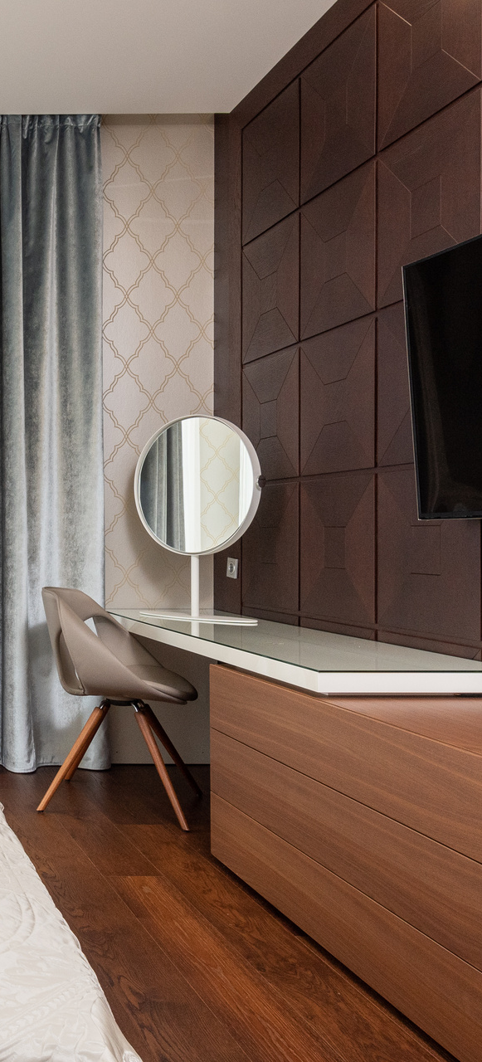
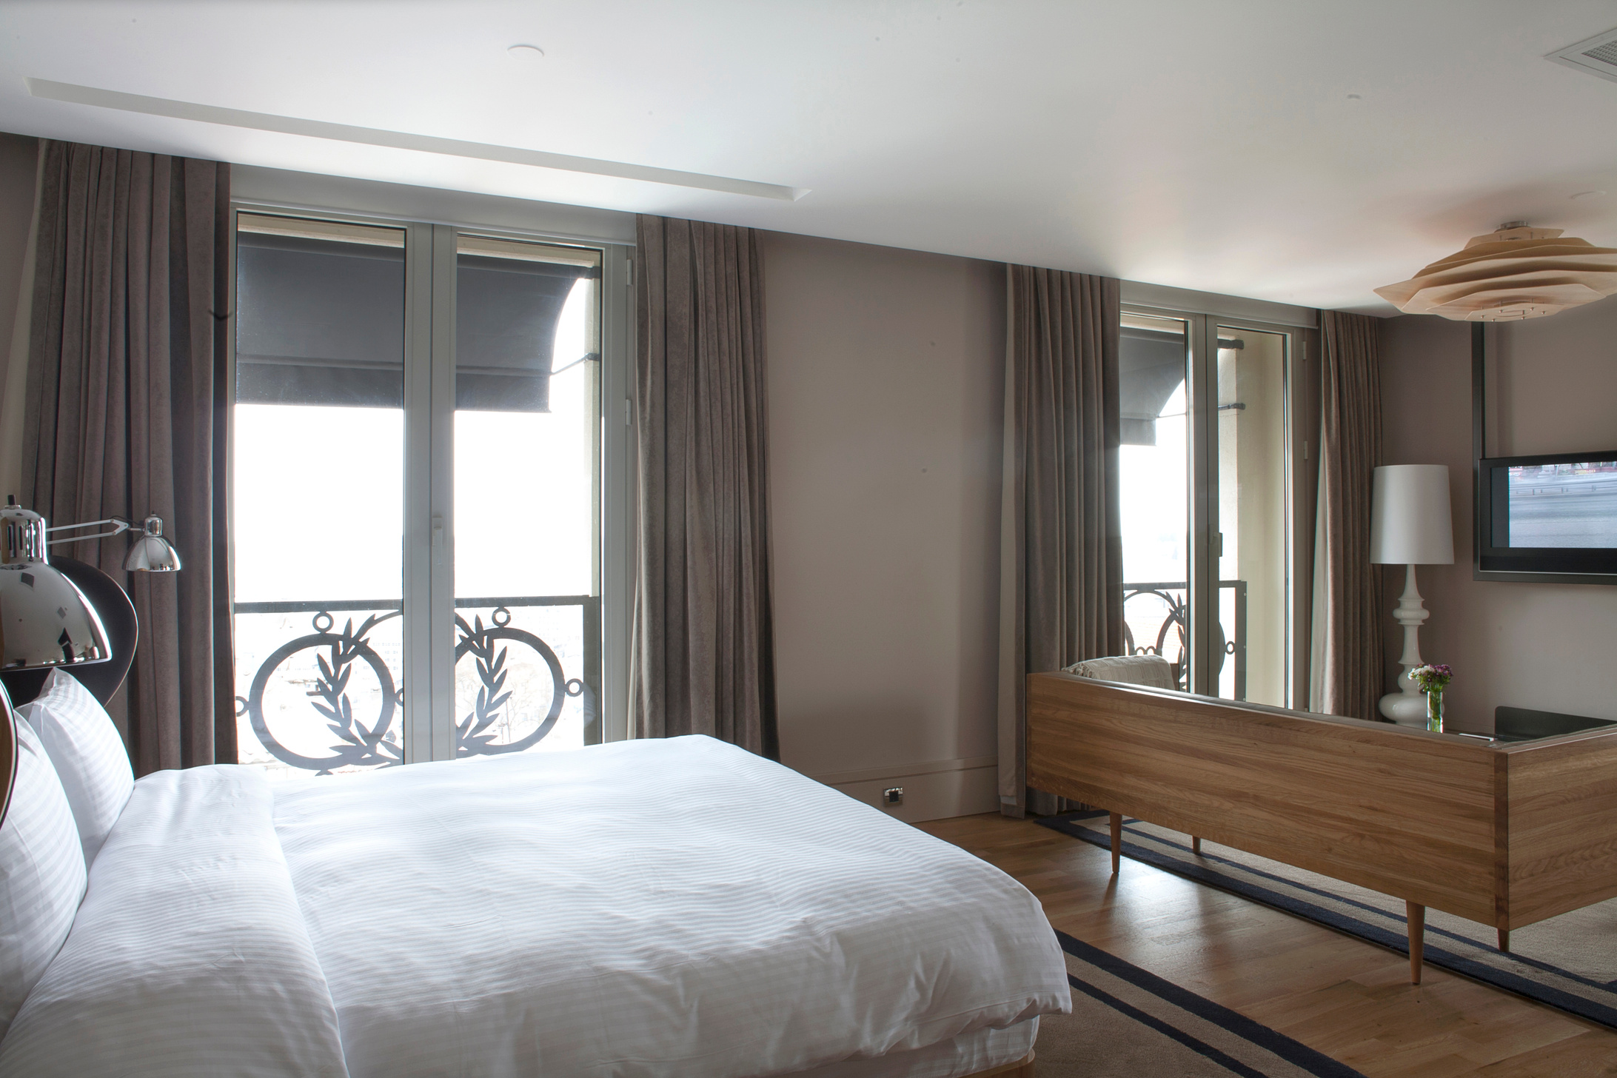
Objectives
General Obejctive
This project involves developing a Java desktop application that connects to a MySQL database. The application is designed to manage hotel room bookings and maintain guest information in an organized and accessible manner.
Specific Objectives
Secure login for authorized staff only.
Booking module with customer search, auto-fill, date and guest selection, and automatic price calculation with discounts.
Room availability list with refresh, sorting occupied and reserved rooms to the top.
Advanced booking management for check-ins, check-outs, cancellations, rescheduling, extensions, upgrades, and filtering by status, payment, or room type.

Slide 6
Scope and Limitations

Slide 7
Scope
Admin login with username and password verified against the database.
Customer records: add new customers or search for returning ones, with names locked to prevent accidental edits.
Bookings: reserve rooms, set dates, add extra charges, apply Senior or PWD discounts, and compute the total price.
Room status: display all rooms in a table, dynamically sorted by Occupied, Reserved, and Available, with a refresh button for updates.
Manage reservations: staff can process check-ins, check-outs, and cancellations.
Modifying stays: upgrade room category, extend the check-out date, or reschedule bookings with an automatic 15% charge.
Filtering: sort reservations by status, payment method, or room type using apply and clear filter buttons.
MySQL database connection via JDBC.

Slide 8
Limitations
This is a desktop application only. It will not run on mobile phones or web browsers.
It does not handle actual online payments. Staff collect payment manually and only record the method used, either Cash or GCash QR Scan.
The system does not send automatic emails or text messages to customers.
It runs on a single local computer only and does not support multiple hotel branches.

Slide 9
SYSTEM FEATURES & MODULES

Slide 10
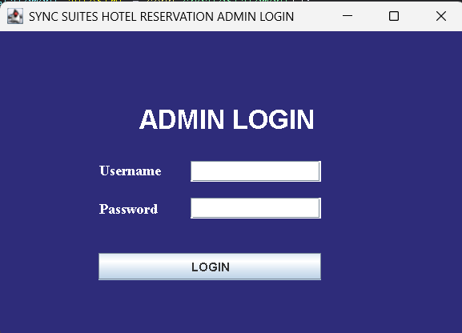
Login Module
Prompts for username and password. Staff can press Enter to log in instantly. Valid credentials open the maximized main dashboard; invalid ones trigger a warning message.

Slide 11
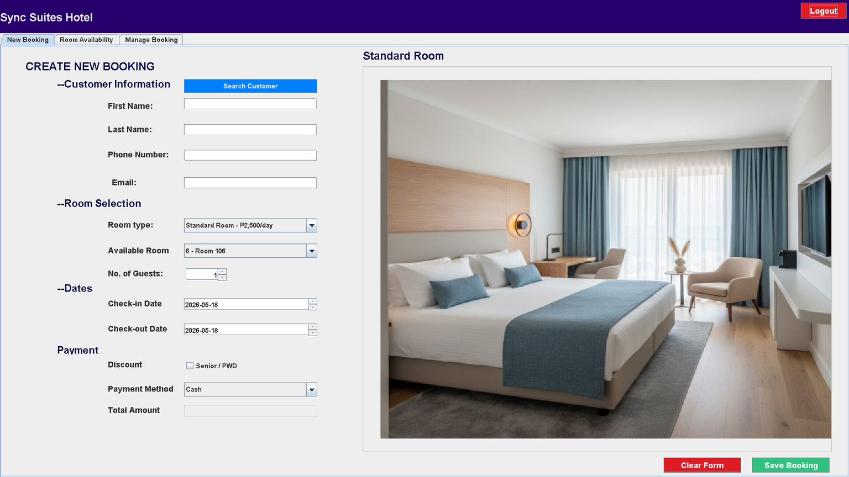
New Booking Module
Staff fill out a guest form with a search button to find returning customers quickly. They can enter guest count, select room types, check a box for Senior or PWD discounts, and view the total amount due.

Slide 12
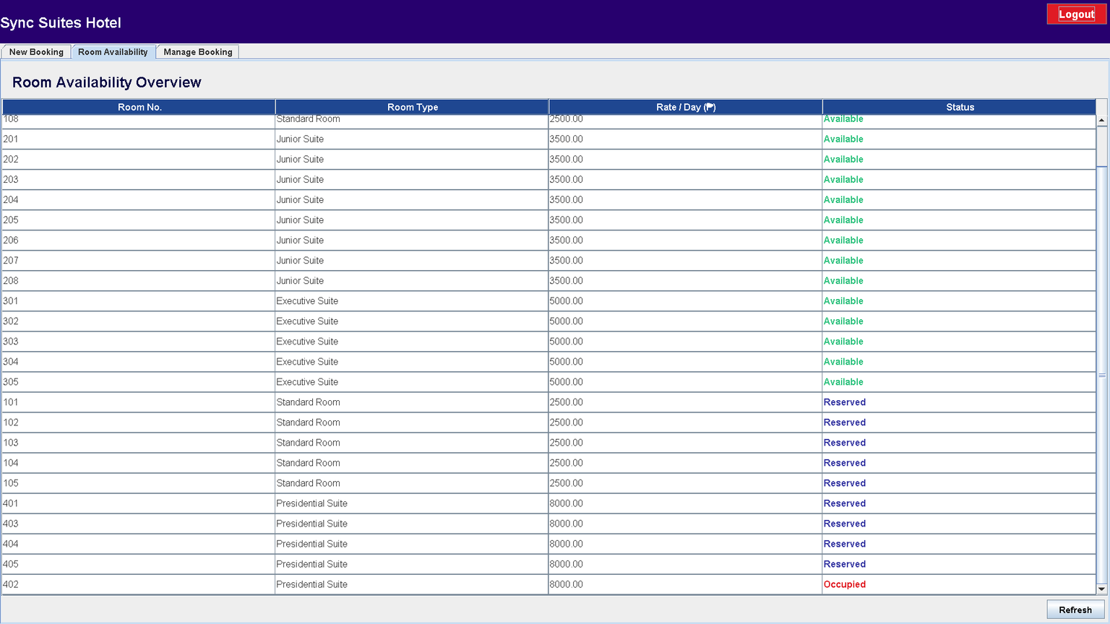
Room Availability Module
A read-only table listing every room. Includes a Refresh button and auto-sorts by status: Occupied, then Reserved, then Available.

Slide 13
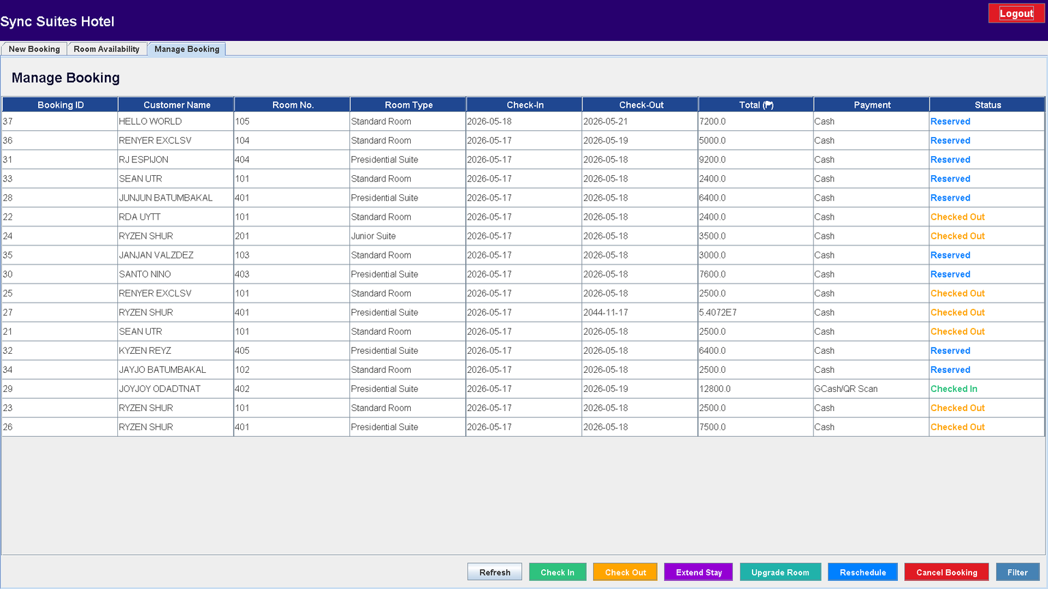
Room Availability Module
A table of all reservations with buttons to Check-In, Check-Out, or Cancel. Advanced options include Extend Stay, Upgrade Room, and Reschedule (which adds a 15% charge). A Filter dialog lets staff Apply or Clear filters by Status, Payment, or Room Type.

Slide 14
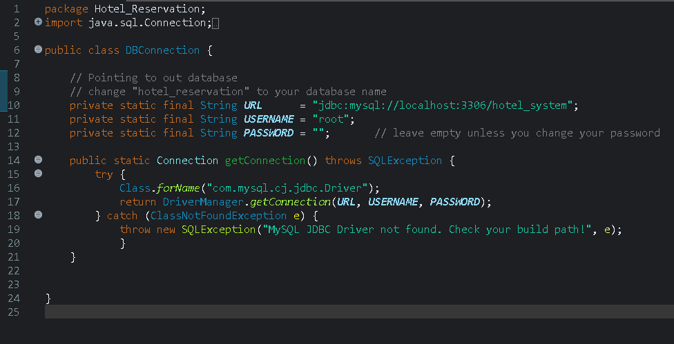
Sample JDBC Connection Code

Slide 15
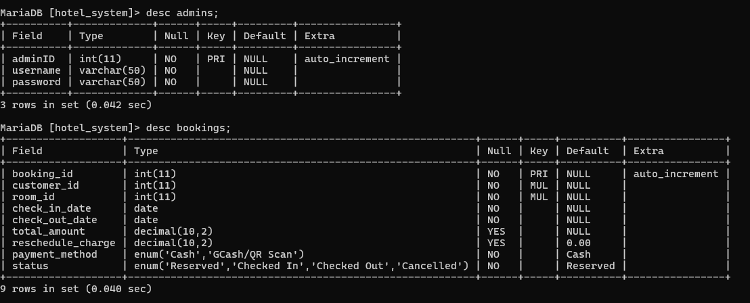
Tables

Slide 16
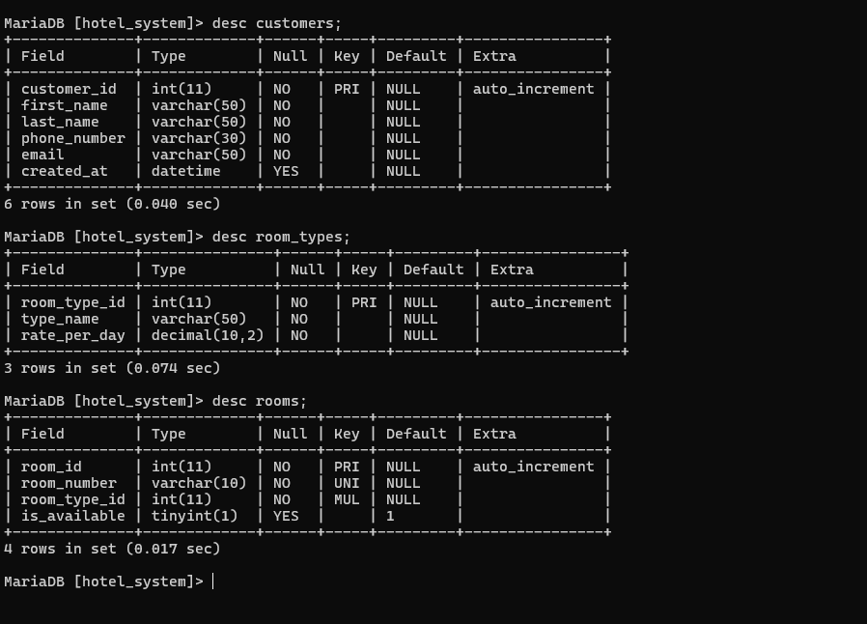
Tables

Slide 17
UML CLASS DIAGRAM

Slide 18
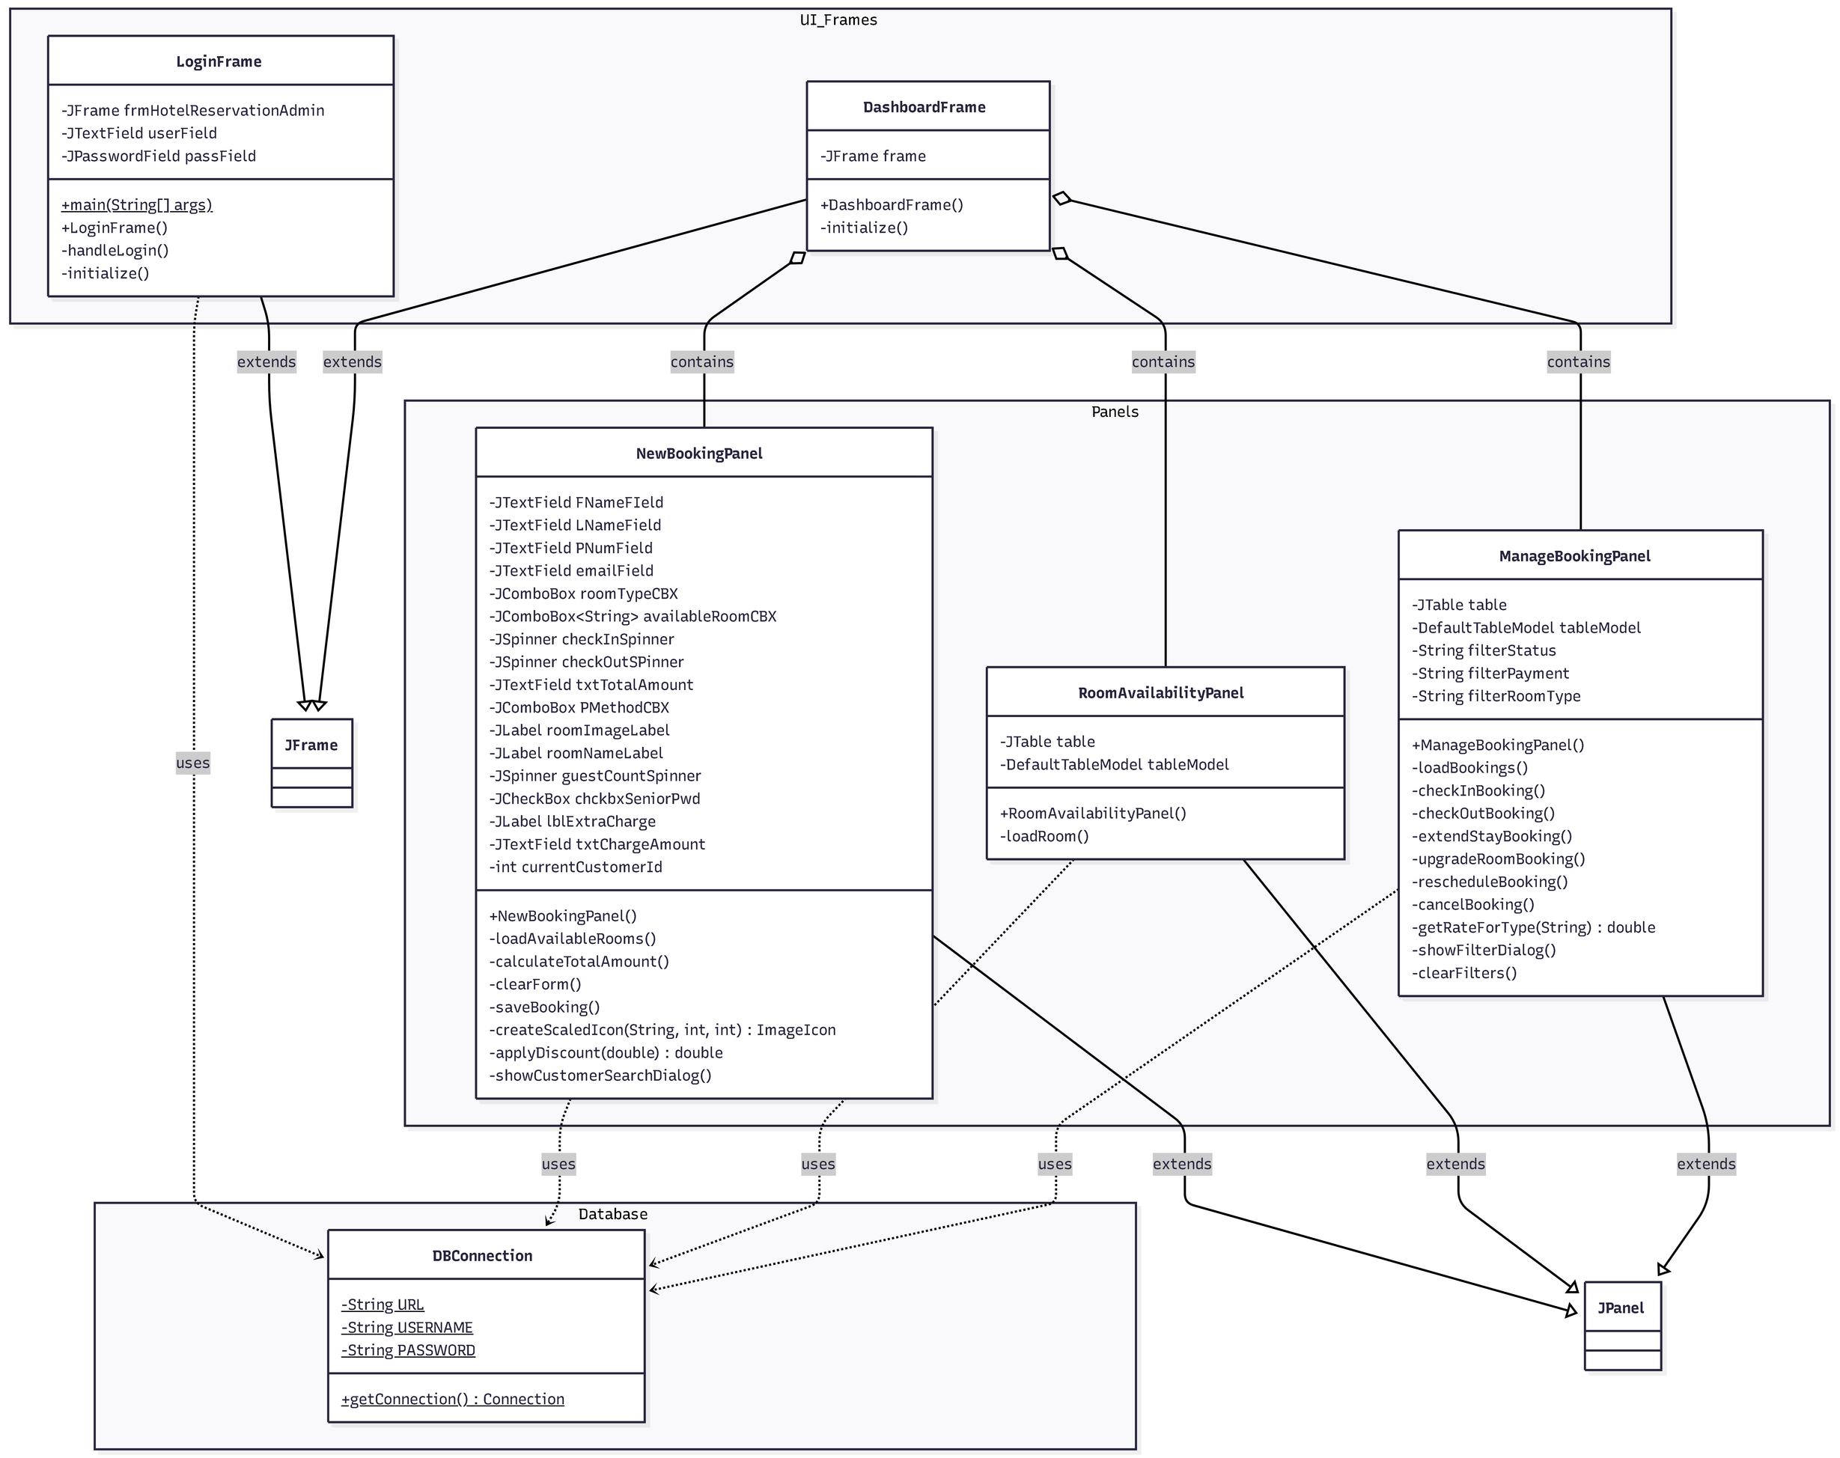

Slide 19
UML CASE DIAGRAM

Slide 20
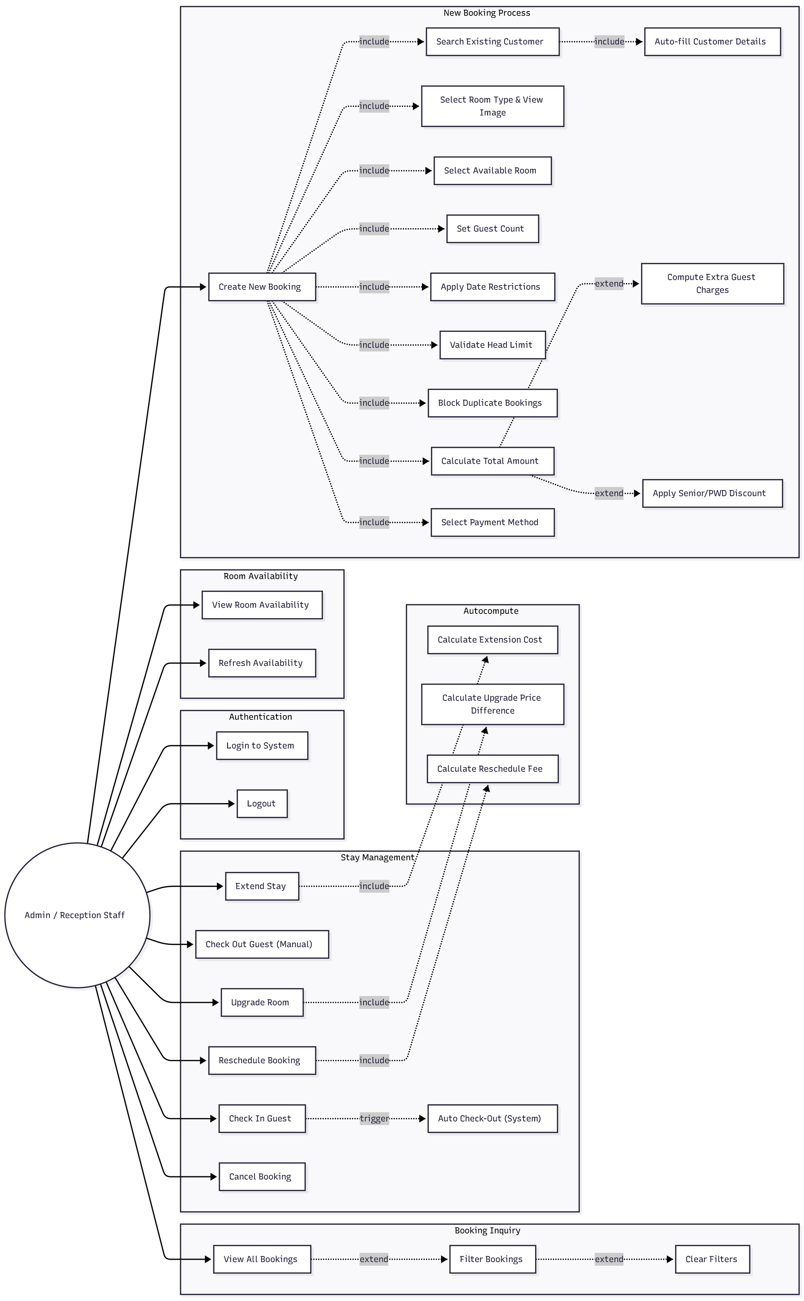

Slide 22
DATABASE
SCHEMA

Slide 23
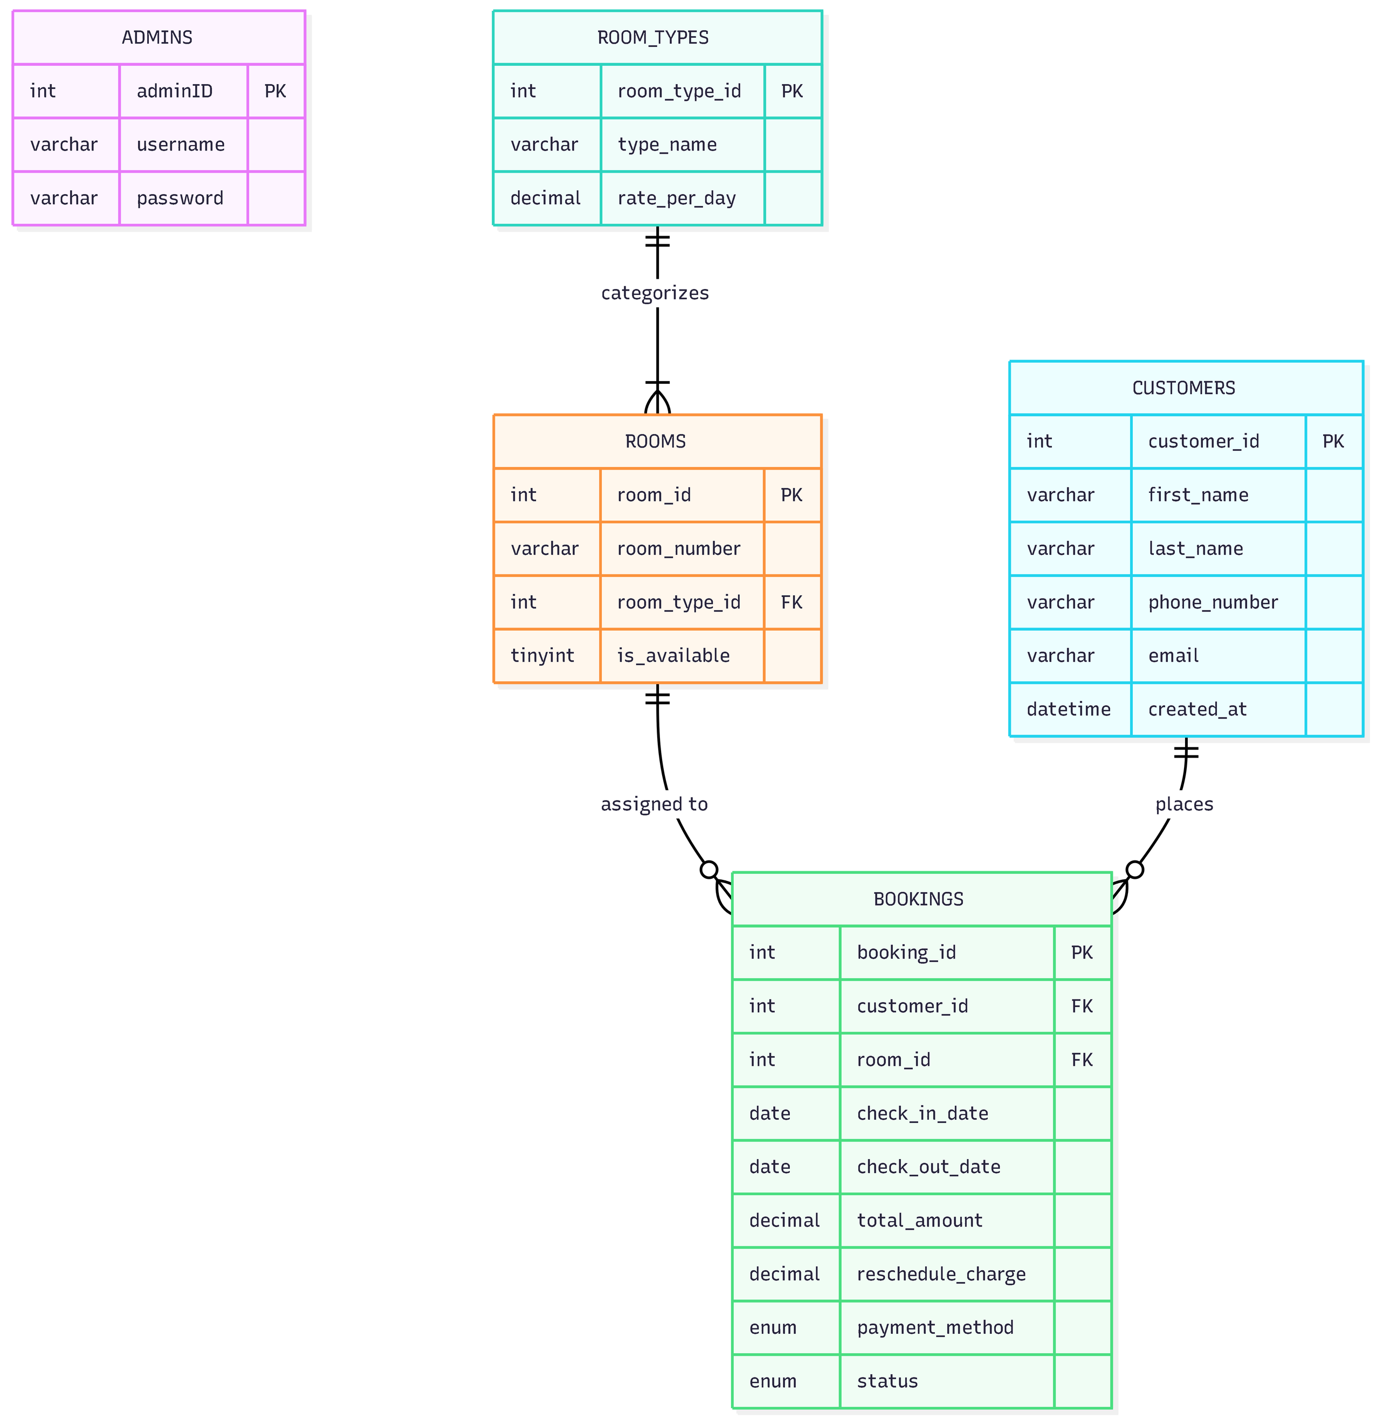

Slide 24
SYSTEM
DEMONSTRATION

Slide 25

Thank You
SYNC SUITES HOTEL RESERVATION SYSTEM

